Slide 1
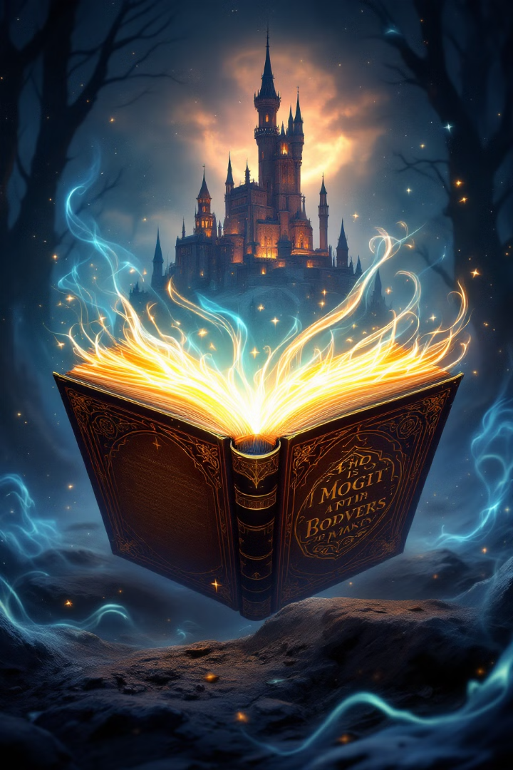
Mystic AI: Interactive Storytelling Reimagined
Mystic AI is a dynamic story experience using OpenAI's ChatGPT and DALL-E.

Slide 2
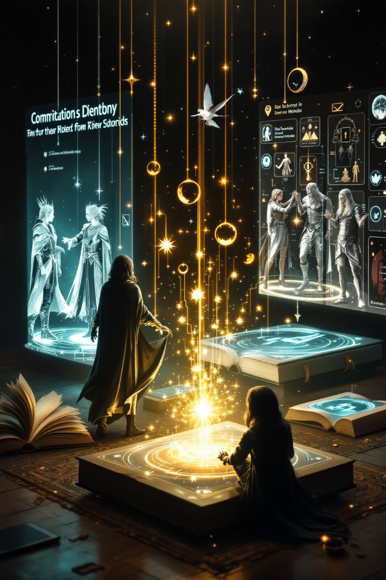
Executive Summary
Mystic AI - Dynamic Story Creator
The app features API Key Authentication for secure access, Dynamic Story Generation using ChatGPT, and AI-Generated Images from DALL-E. Users can make Interactive Choices to influence the story. Session State Management handles inputs and app state, while the Sidebar provides instructions and API key input.
Team Goal - How can Mystic AI leverage advanced AI models and interactive storytelling techniques to create engaging, educational experiences that are both immersive and informative?

Slide 3
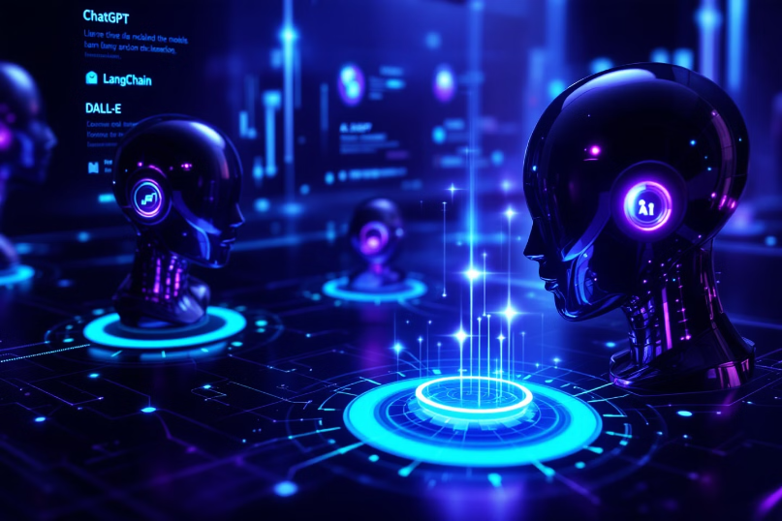
Exploration and Optimization
Model Exploration & Optimization
Our team rigorously evaluated ChatGPT, DALL-E, and LangChain capabilities for interactive storytelling.
Leveraged prompt engineering techniques for optimal responses
Reduced DALL-E image generation load times by 34%
Fine-tuned LangChain for seamless conversation flows

Slide 4








Team Approach
Communication
Documentation
Ensured open communication and regular meetings.
Managed documentation and project details.
Technical
Design
Contributed coding and optimization expertise.
Focused on UI design and user experience.

Slide 5








Technology Behind Mystic AI
User Experience
Seamless interactive storytelling interface
LangChain
Dynamic narrative construction framework
DALL-E
Real-time visual storytelling elements
GPT-4
Advanced natural language generation

Slide 6





How Mystic AI Works
User Input
Player provides initial theme
AI Processing
System generates narrative framework and initial scenario
Branching Paths
Story develops based on user choices and interactions
Visual Generation
DALL-E creates imagery matching story developments

Slide 7
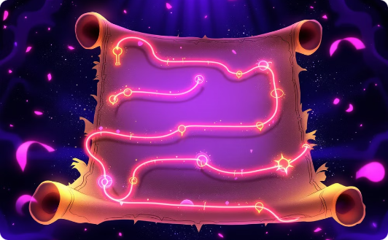
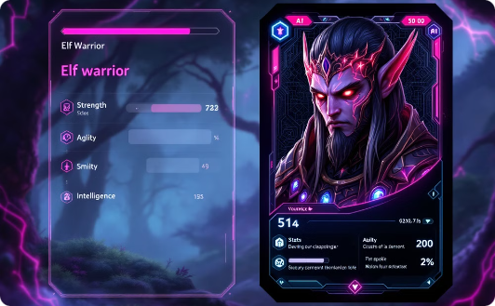

Interactive Storytelling Mechanics
Branching Narratives
Conversation Chain
Image Creation
Story paths evolve based on user decisions.
AI enhances conversations by enabling detailed prompts.
Visualization emerges from story development.

Slide 8




Future Development
Enhance Story Coherence
Ensure consistent storytelling with memory mechanisms. Fine-tune ChatGPT for domain-specific narratives.
Expand User Interactivity
Support complex branching narratives and user-defined elements. Add a "sandbox mode" for direct story editing.
Incorporate Additional AI Models
Experiment with AI models like Stable Diffusion or GPT-4. Add voice synthesis for narration.
Expand Use Cases
Adapt for educational use and engagement.

Slide 9
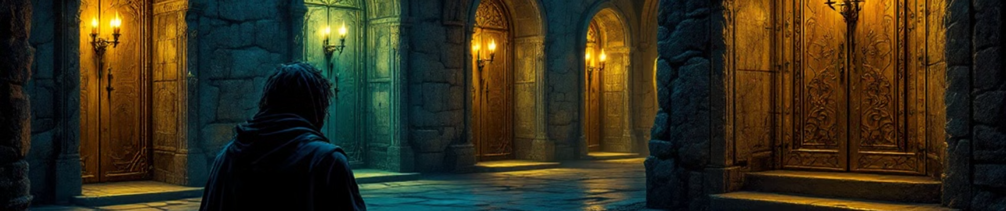
Conclusion
Mystic AI can leverage advanced AI models like ChatGPT, GPT-40 Mini, and DALL-E, combined with interactive storytelling techniques, to craft engaging and educational experiences. By dynamically generating narratives based on user inputs and incorporating visually stimulating images, Mystic AI can create immersive environments that captivate users. Additionally, the integration of Langchain for conversation management ensures seamless interactions, allowing users to explore and learn through their choices. This approach not only makes the experience informative but also deeply engaging, fostering a unique blend of entertainment and education.

Slide 10

StreamLit Demonstration
Mystic AI - Dynamic Story Creator

Slide 11
Appendix & Resources
GitHub Repository
Presentation
Additional Materials
Access our complete codebase and documentation at https://github.com/xraySMULu/project-3
Download this presentation in PDF format at https://github.com/xraySMULu/project-3/blob/master/resources/presentation/Mystic-AI.pdf
Demo videos, research papers, and implementation guides are available in the resources folder.
All resources are open source under MIT license. Feel free to fork, modify, and extend our work as you explore interactive AI storytelling platforms.

